Slide 1
Huffman Coding

Slide 2
What is Huffman Code
A lossless data compression algorithm that reduces file size by assigning shorter binary codes to frequently occurring characters.
Developed by David A. Huffman in 1952.
widely used in file compression formats like ZIP, JPEG, and MP3.
Ensures lossless compression , meaning no data is lost during compression or decompression.

Slide 3
Key concepts
Variable-Length Encoding : Each character is assigned a unique binary code. Frequent characters have shorter codes, while infrequent ones have longer codes.
Prefix Property : No binary code is a prefix of another. This ensures that the encoded data can be uniquely decoded without ambiguity.
Binary Tree Representation : The algorithm uses a binary tree (called a Huffman Tree ) to represent the encoding process.

Slide 4
Benefits and Use Cases
Efficient Compression: It offers an optimal method for character data compression.
Lossless: Huffman Coding is lossless, meaning the original data can be perfectly reconstructed from the compressed data.
Wide Use: It is used in various applications, from computer networking to storage systems. i.e. ZIP files, PNG images, Networking Protocols

Slide 5
Steps of the Huffman Coding Algorithm
Calculate Frequencies :
Count the frequency of each character in the input data.
Build a Priority Queue (Min-Heap) :
Create a priority queue (or min-heap) where each node represents a character and its frequency. Nodes are ordered by frequency (lowest first).
Select two parentless nodes with the lowest frequency.
Create a new node which is the parent of the two lowest frequency node.
Label the left link with 0 and the right link with 1.
Assign the new node a frequency equal to sum of it’s children frequencies.
Repeat steps 3 through 6 until there is only one parentless node left.

Slide 6

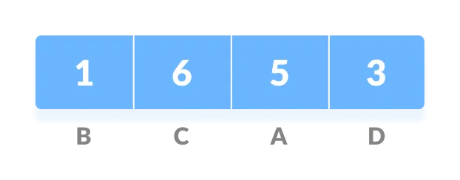
How It Works: (Example)
Message
Each character occupies 8 bits. There are a total of 15 characters in the above string. Thus, a total of 8 * 15 = 120 bits are required to send this string.
Calculate the frequency of each character in the string.

Slide 7
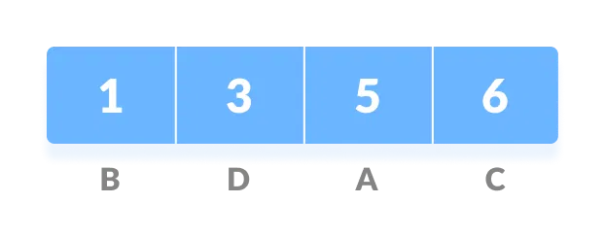
2 . Sort the characters in increasing order of the frequency.
3. Make each unique character as a leaf node.

Slide 8
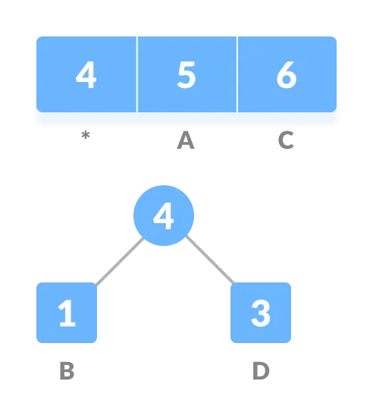
4.Create an empty node “z”. Assign the minimum frequency to the left child of z and assign the second minimum frequency to the right child of z. Set the value of the z as the sum of the above two minimum frequencies.
Take minimum and add them now the root node of letter B and D is 4.

Slide 9
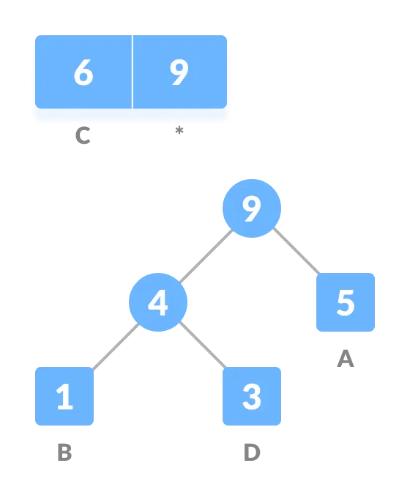
5. Remove these two minimum frequencies from Q and add the sum into the list of frequencies (* denote the internal nodes in the figure above).
6. Insert node z into the tree.
7. Repeat steps 3 to 5 for all the characters.

Slide 10
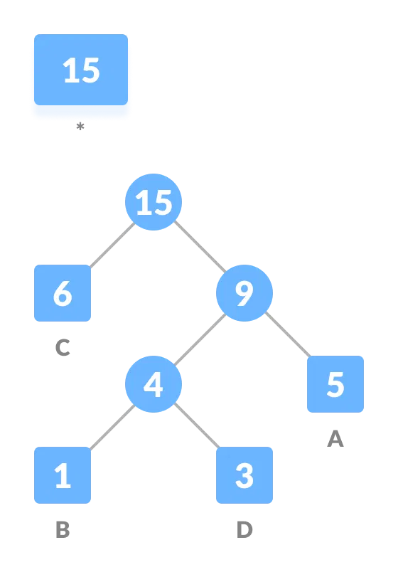
B | 1
C | 6
A | 5
D | 3

Slide 11
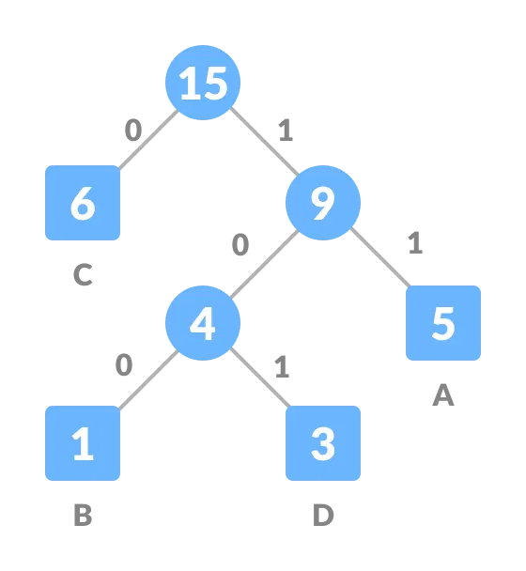
For each non-leaf node, assign 0 to the left edge and 1 to the right edge.

Slide 12
Challenges and Limitations
Frequency Requirement: The algorithm requires knowledge of the frequency occurrence of each character, which may not always be readily available or accurate.
Limited Compression: When dealing with evenly distributed symbols data, Huffman Coding may not achieve significant compression.

Slide 13
Time Complexity
The time complexity of Huffman coding is O(nlogn)

Slide 14
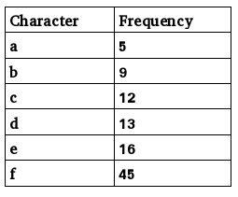
Exercise

Slide 15
Prim's Algorithm Minimum Spanning Tree

Slide 16
Table of Content:
Prerequisite
Introduction to spanning and minimum spanning tree
What is Prim’s Algorithm.
Steps of Prim’s Algorithm with Example
Applications
Why Prim’s Algorithm?
Why Not Kruskal’s?

Slide 17
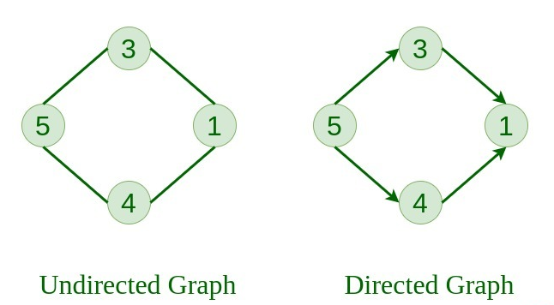
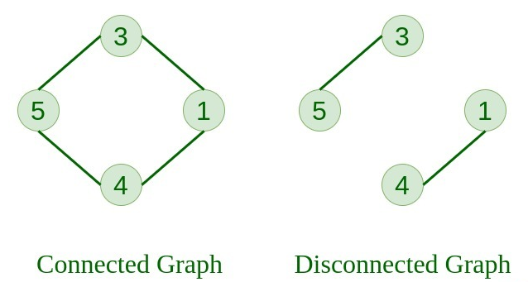
Prerequesit:

Slide 18
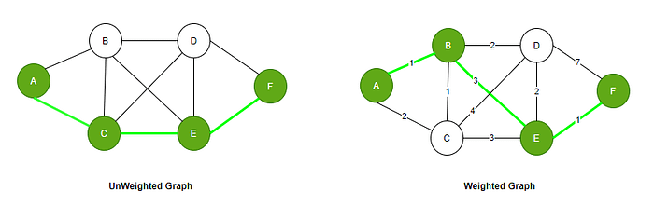
Prerequesit:

Slide 19
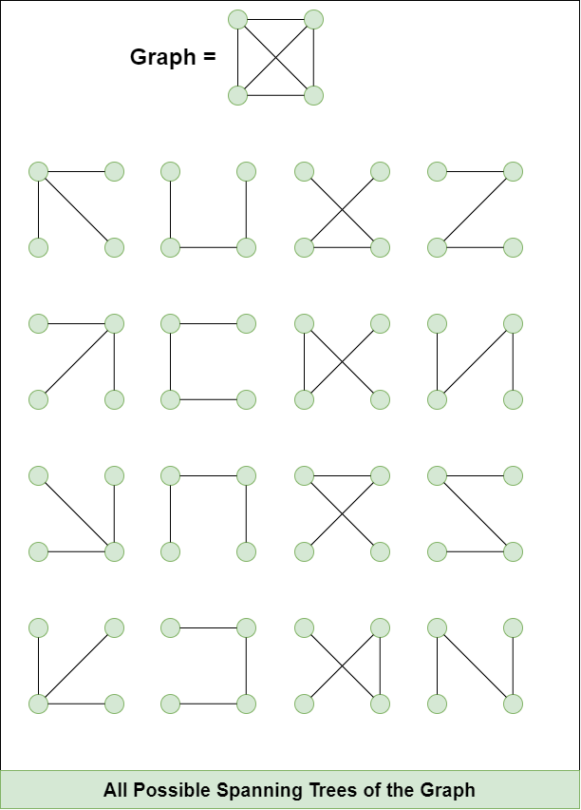
Spanning Tree:
A spanning tree is a subset of a graph that connects all vertices without any cycles.
If a graph has V vertices, a spanning tree has exactly V - 1 edges.

Slide 20
Properties of a Spanning Tree:
A Spanning tree does not exist for a disconnected graph.
A Spanning tree does not have any cycle.
Cayley's Formula: It states that the number of spanning trees in a complete graph with N vertices is N^(N−2)
For example: N=4, then maximum number of spanning tree possible = 4^4-2 = 16.

Slide 21
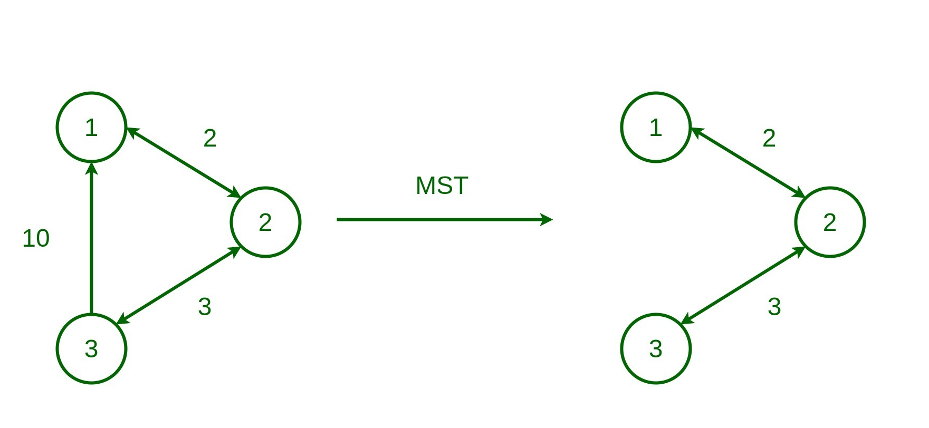
Minimum Spanning Tree(MST):
Among all possible spanning trees, the MST is the one with the lowest total edge weight.
MST can only be found in connected and weighted graphs.

Slide 22
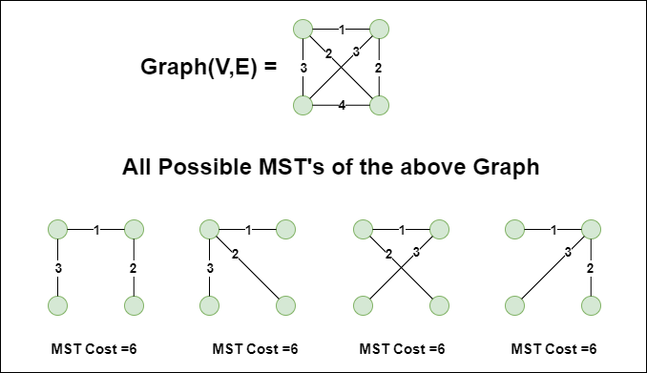
Minimum Spanning Tree(MST):

Slide 23
Algorithms to Find MST of a Graph:
Two popular algorithms to find MST:
Prim’s Algorithm (grows MST from one vertex)
Kruskal’s Algorithm (starts from minimum edeges)

Slide 24
What is Prim's Algorithm?
Prim's algorithm was invented in 1930 .
Prim's algorithm finds the Minimum Spanning Tree (MST) in a connected and undirected graph.
Starts with a single vertex and adds the lowest-weight edge that connects a new vertex to the growing tree.

Slide 25
Steps of Prim’s Algorithm
Remove loops and Parallel edges .
Start with any node.
Pick the smallest edge that connects the MST to a new node.
Add that edge and node to the MST.
Repeat until all nodes are connected.

Slide 26
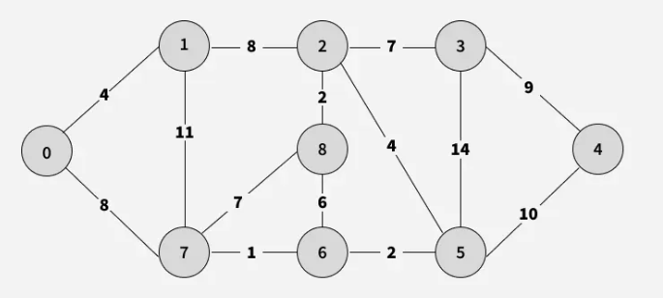
Example:

Slide 27
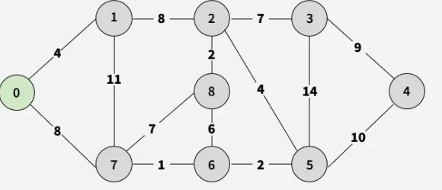
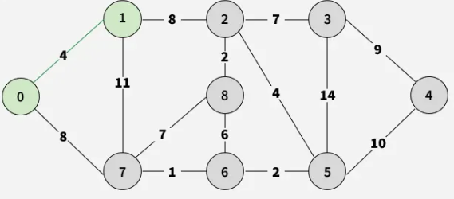
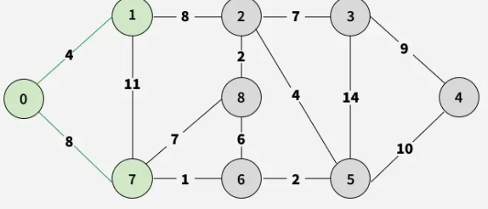
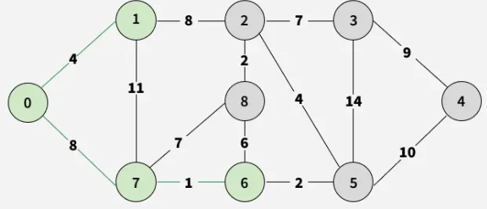
Example:

Slide 28
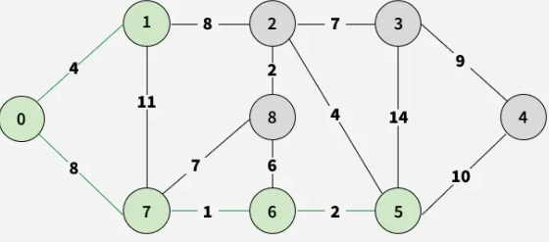
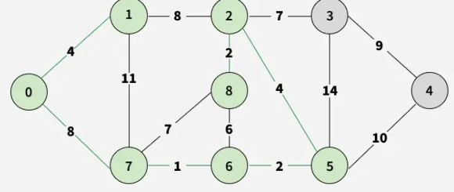
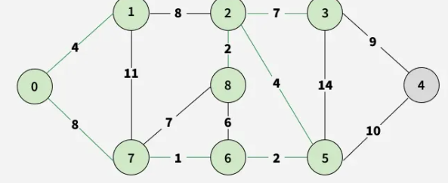
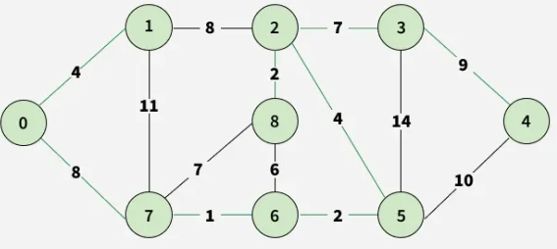
Example:

Slide 29
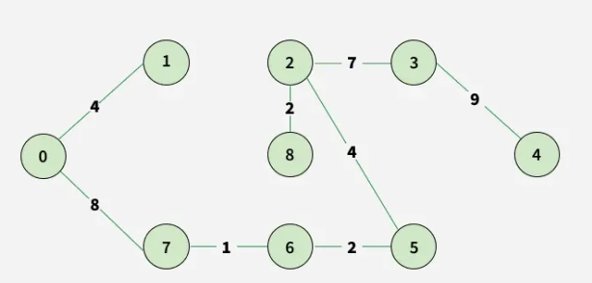
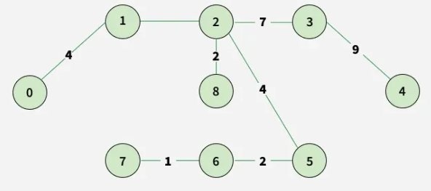
Example:

Slide 30
Applications
Network Design
Designing computer networks, electric grids, or water pipelines to connect all points with minimum total cost.
Road and Railway Construction
Planning transportation infrastructure (roads, railways) to ensure all locations are connected using the shortest total path.

Slide 31
Why Prim's Algorithm?
Good for Dense Graphs
It performs well when the graph has many edges.
Grows the Graph step-by-step from one node, easy to follow.
Builds the MST one vertex at a time, which makes it easier to track and debug during execution.
No Need for Sorting Edges
Unlike Kruskal’s, it doesn’t need to sort all edges first, which can be costly.

Slide 32
Why Not Kruskal’s?
Feature | Prim’s | Kruskal’s
Grows From | A single node | Edge-by-edge globally
Graph Type | Better for dense graphs | Better for sparse graphs
Data Structure | Priority Queue (Min-Heap) | Union-Find / Disjoint Set
Edge Sorting Needed? | ❌ No | ✅ Yes
Implementation | Easy for adjacency lists | More complex logic

